Slide 1
EXPLORE YOUR NEW TOWN
IBM DATA SCIENCE CAPSTONE PROJECT
- MADHUSUDHAN V

Slide 2
INTRODUCTION
I am a prospective Masters Student at the University of South Florida, Tampa.
I am taking up this capstone project to cater needs of International students, since I am one from India. This project will help us to get to know in and out of the neighbourhood of a city where we would be living in future i.e. before arrival on campus. So, that one can be psychologically prepared before actually being there for real and its also a good thing to know a place before you have actually been there. Not only International students even other fellow countrymen from a different location can be benefitted by this project.
Since, I am going to be on USF, Tampa campus this project deals with the neighbourhood of Tampa.

Slide 3
DATA ANALYSIS
There are actually two data sets used in this project:
https://geodata.myflorida.com/datasets/ufl::geoplan-civic-centers-stadiums-and-other-large-capacity-facilities-boundaries-in-florida-2019/data
Foursquare API data
The first data set is taken from geodata.myflorida.com which has the information of all the civic centers, stadiums and other large capacity facilities in Florida which had to be refined a lot, to bring it around to Tampa, even though it was very informative, this data set did not actually cater to daily essentials information. Hence the second data set was chosen which is a Foursquare API data which was leveraged using the venues API call and further transformed into data frame, which actually helped a lot in the exploratory data analysis.
Let’s have a in-depth analysis of these data sets

Slide 4
FIRST DATA SET
In the first data set the data comprises of the entire information of Florida consisting of 355 rows and 27 columns.
Since, our area of interest is only Tampa let’s refine it by using column selection technique and see the results brought down to Tampa. Which has 16 rows and 8 columns.

Slide 5
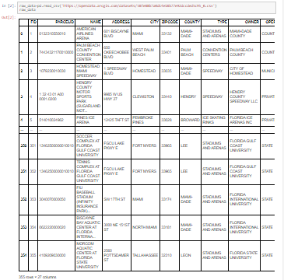
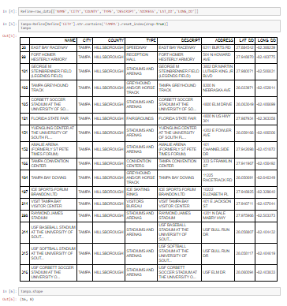
FIRST DATA SET
Before Refining
After Refining

Slide 6
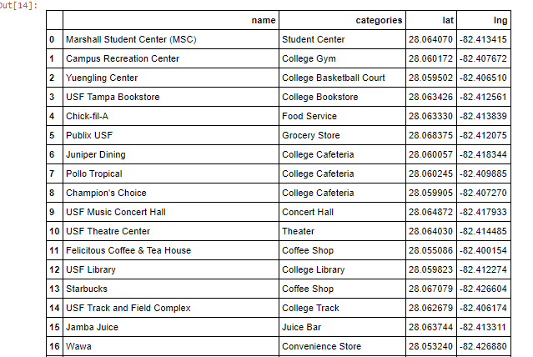
SECOND DATA SET
Even though this data set had a lot of information it didn’t actually deal with what exactly was needed so the Foursquare API’s venues API calls were made to collect the actual data required

Slide 7
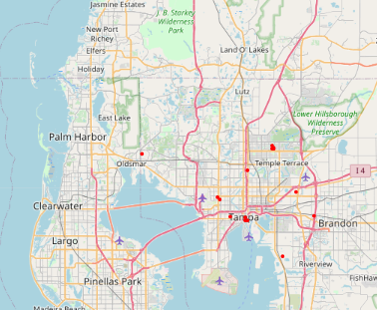
METHODOLOGY
This section deals with the various methods involved to carryout the exploratory data analysis on the above two data sets
FIRST DATA SET
The first data set had a pretty much straight forward approach since it had all the necessary data priorly and the only thing left to do was to just plot those places on the map, which is as follows:

Slide 8
METHODOLOGY
SECOND DATA SET
The second data set was obtained from Foursquare API servers by making venues API calls, since it’s retrieved as a json file it has to be converted into a data frame format first. After this step comes the Exploratory data analysis where all the data in this data set has been encoded using one-hot encoding where all the values will be either 0 or 1, then are grouped together based on the frequency calculated and are then further segmented into venues with the most common appearing first and so on.

Slide 9
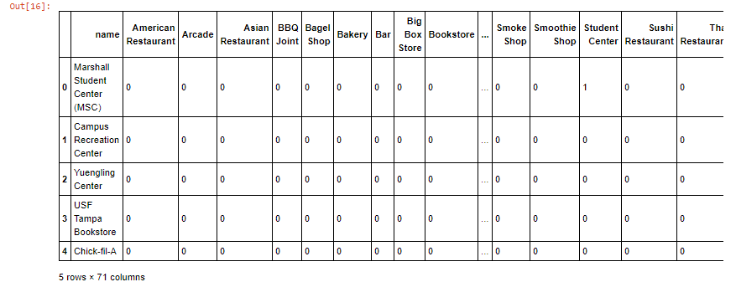
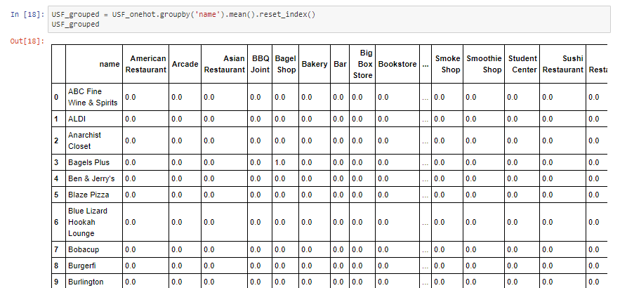
METHODOLOGY
One-hot encoding Grouping

Slide 10
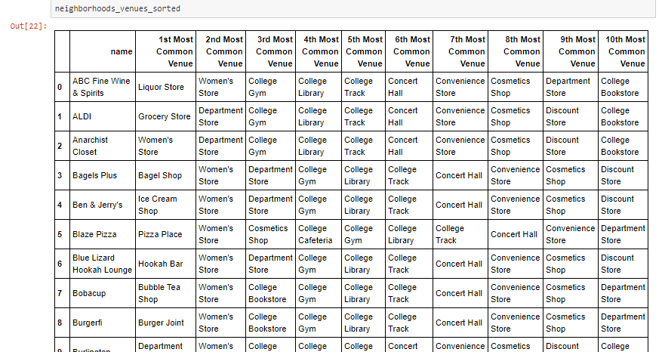
METHODOLOGY
Grouping based on common venues
After all these steps of working on with data the data set is further subjected to clustering which actually filters and classifies all these data into different categories which we will further see in results section.

Slide 11
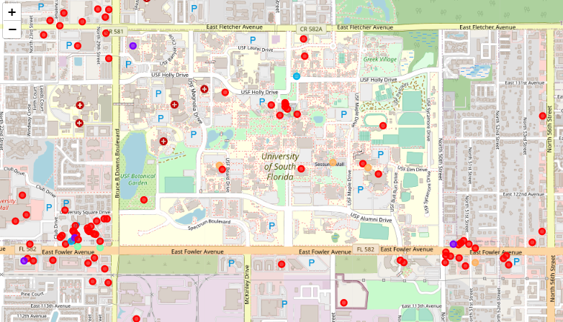
RESULTS
The data set will now be subjected to clustering using k-means clustering method where k is the number of clusters to be formed here in our data set the algorithm has classified the data set into 5 clusters which is as follows:

Slide 12
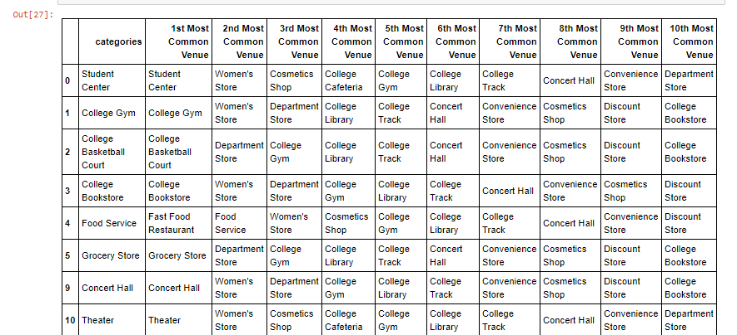
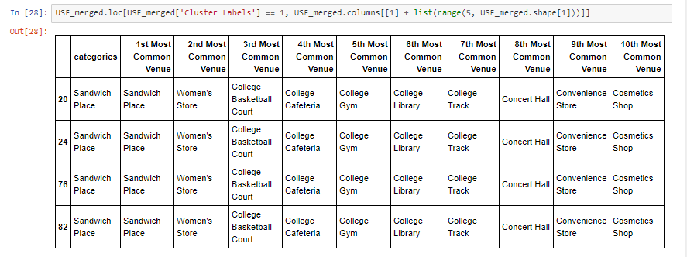
RESULTS
CLUSTER 1
CLUSTER 2

Slide 13
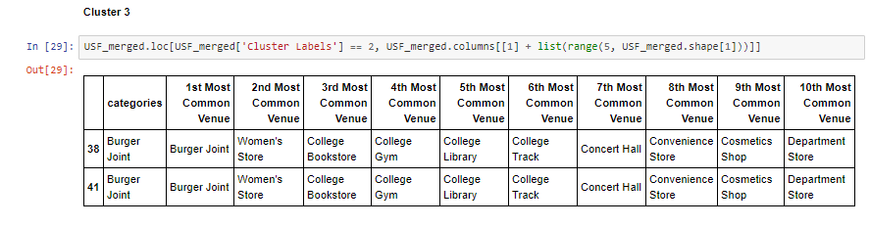
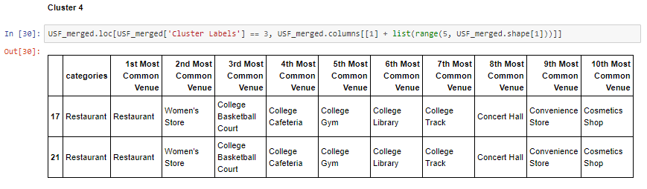
RESULTS
CLUSTER 3
CLUSTER 4

Slide 14
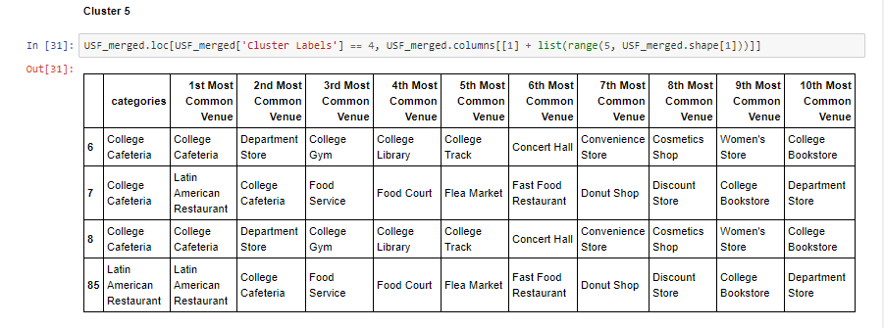
RESULTS
CLUSTER 5

Slide 15
DISCUSSION
Hence, Clustering has helped us a lot to differentiate different places around campus into many categories such as:
1.Student Centers
2.Sandwich place
3.Burger joint
4.Restuarant
5.College Cafeteria

Slide 16
CONCLUSION
Therefore with the help of data science techniques we were able to explore the Tampa neighbourhood which can be a life saver for new comers on this locality.

Slide 17
THANK YOU

